Slide 1
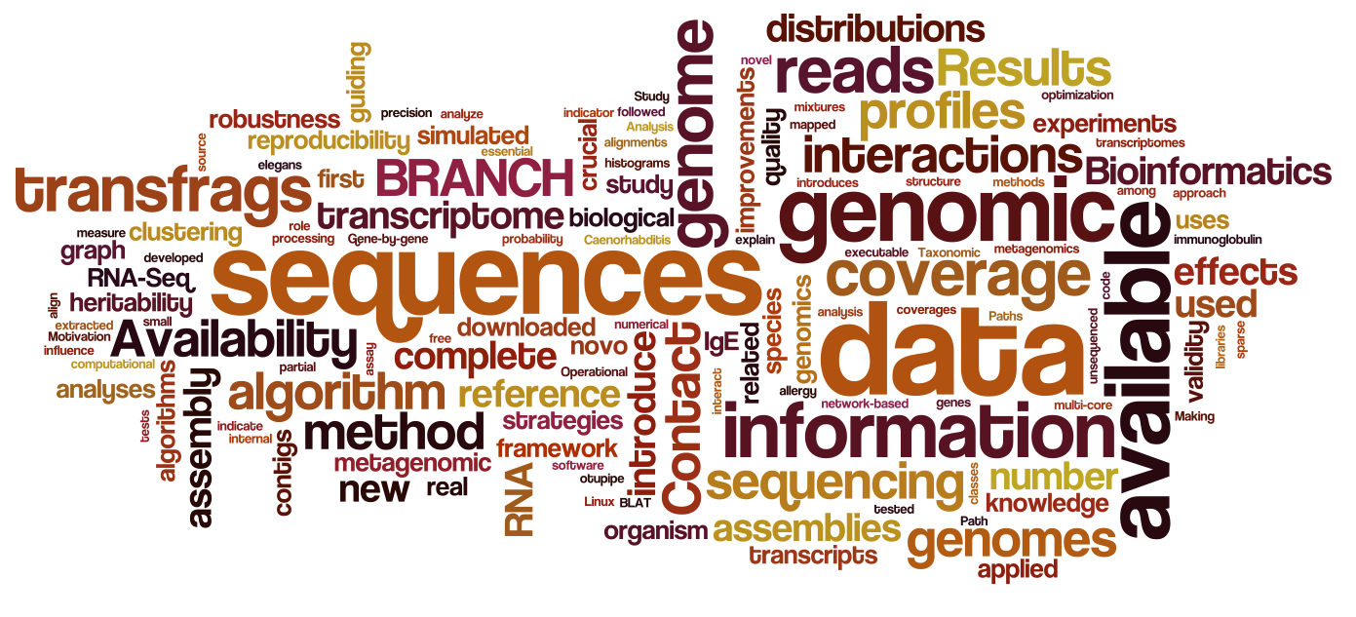
Introduction to Data Science for Biology
Jarrett Byrnes
UMass Boston
Spring 2016

Slide 2
We Are Awash in Data

Slide 3
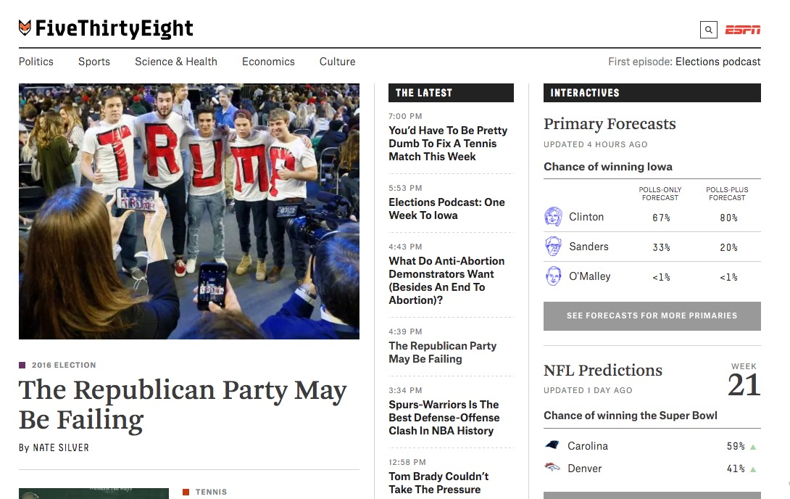

Slide 4
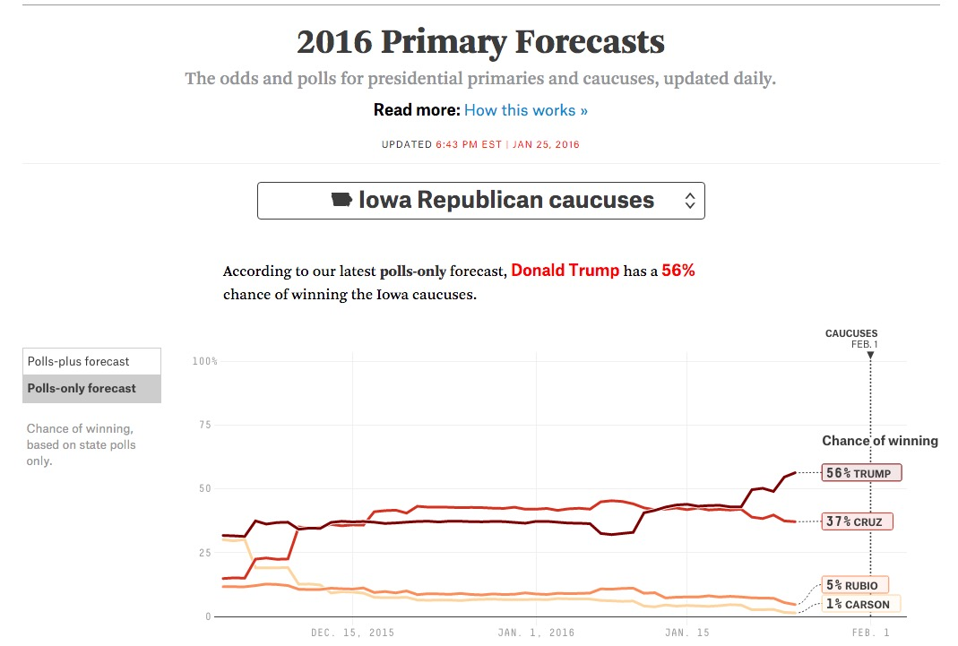

Slide 5
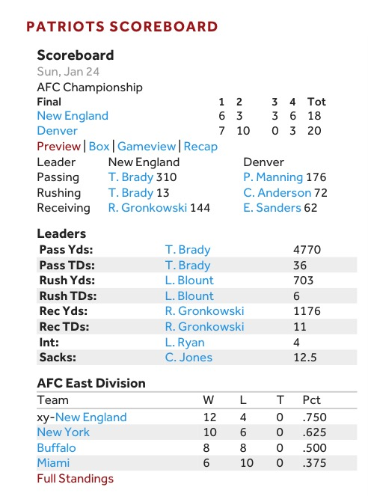
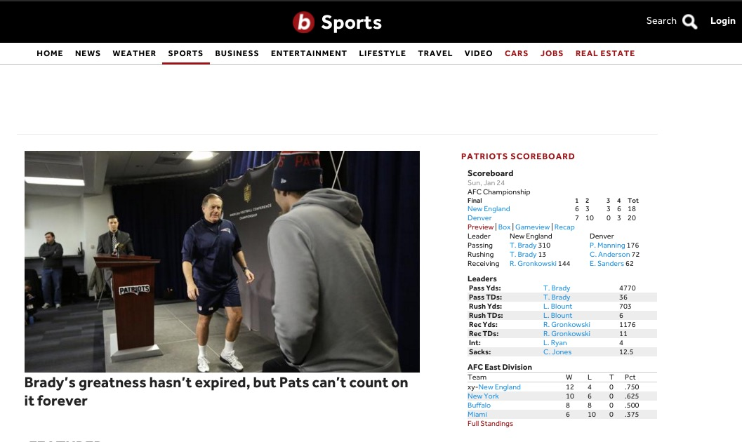

Slide 6
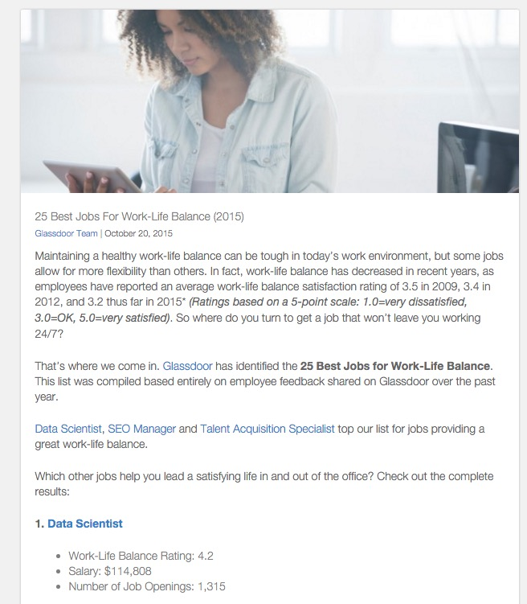
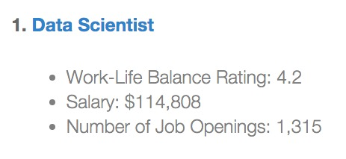

Slide 7
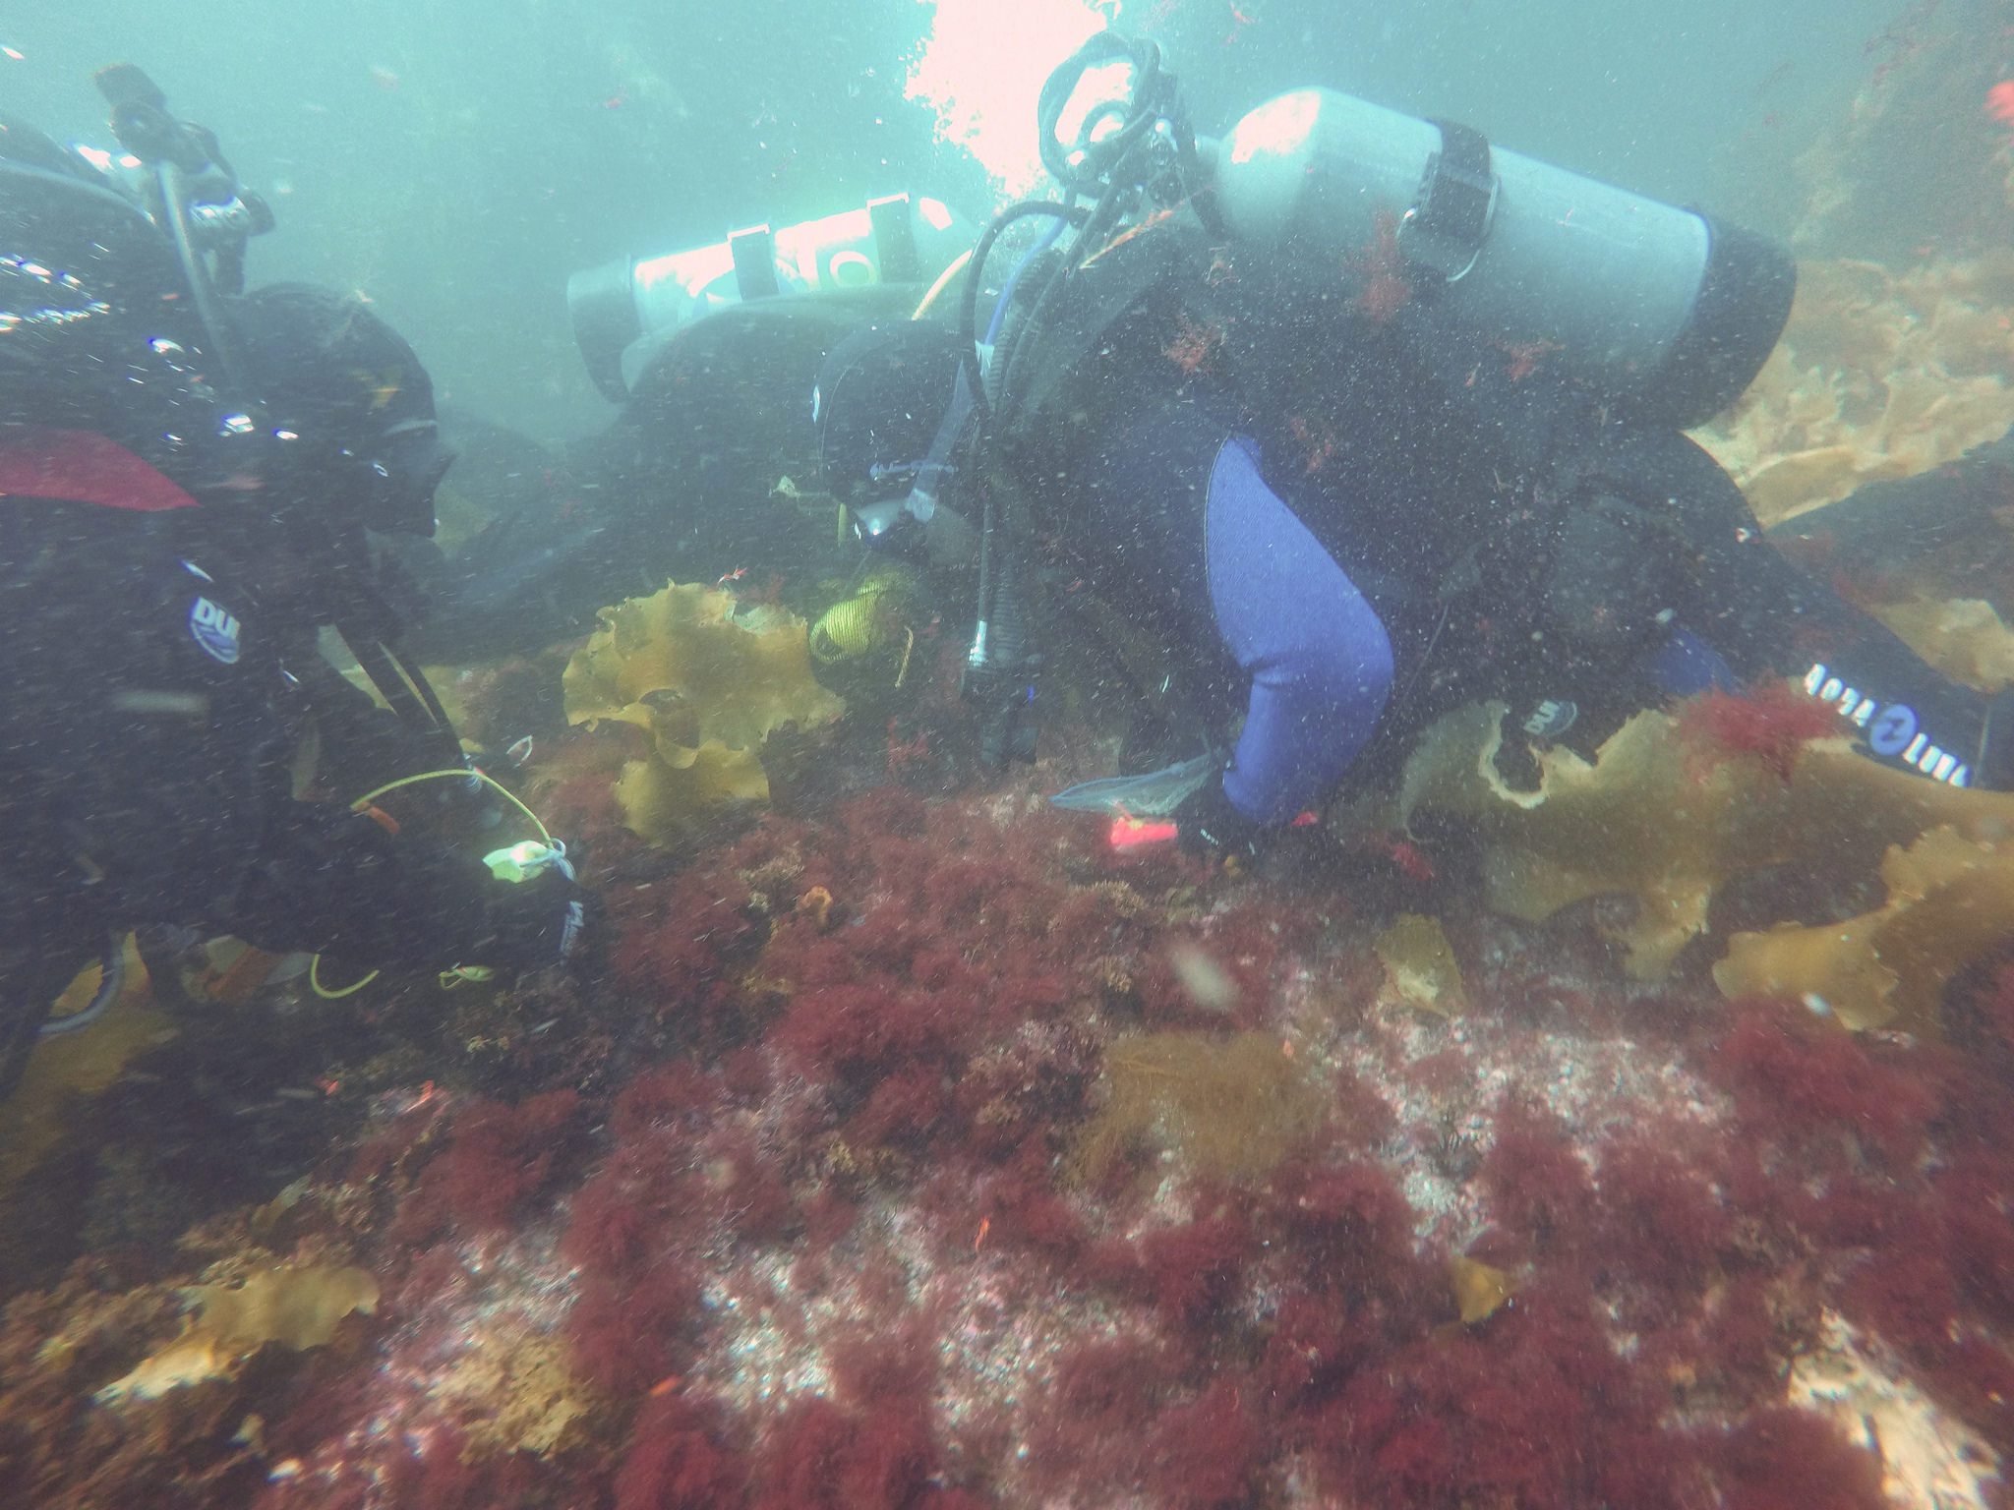

Slide 8
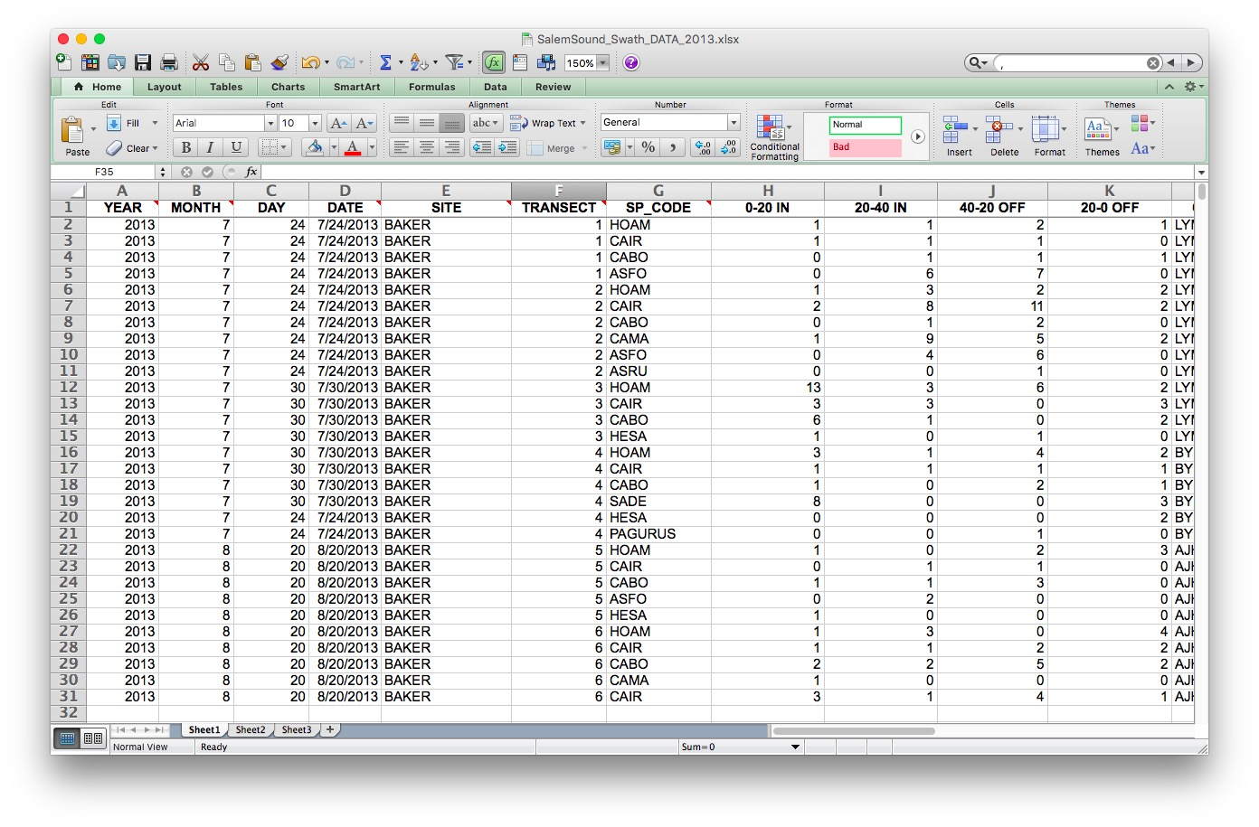

Slide 9
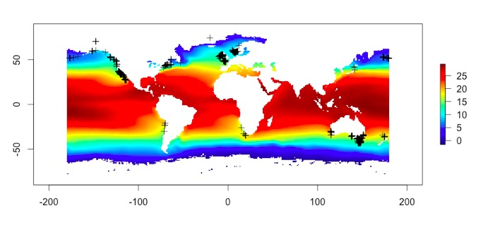

Slide 10
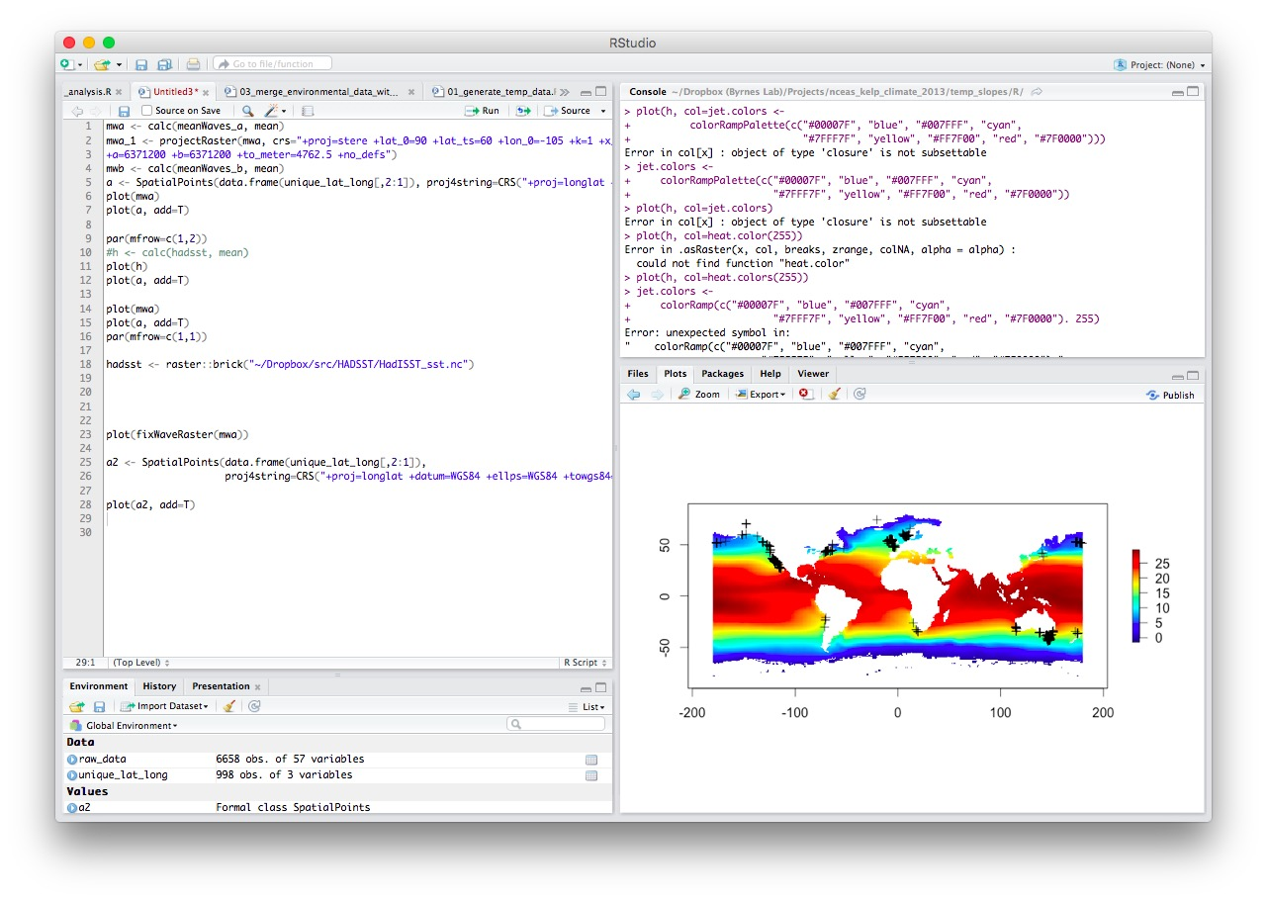

Slide 11
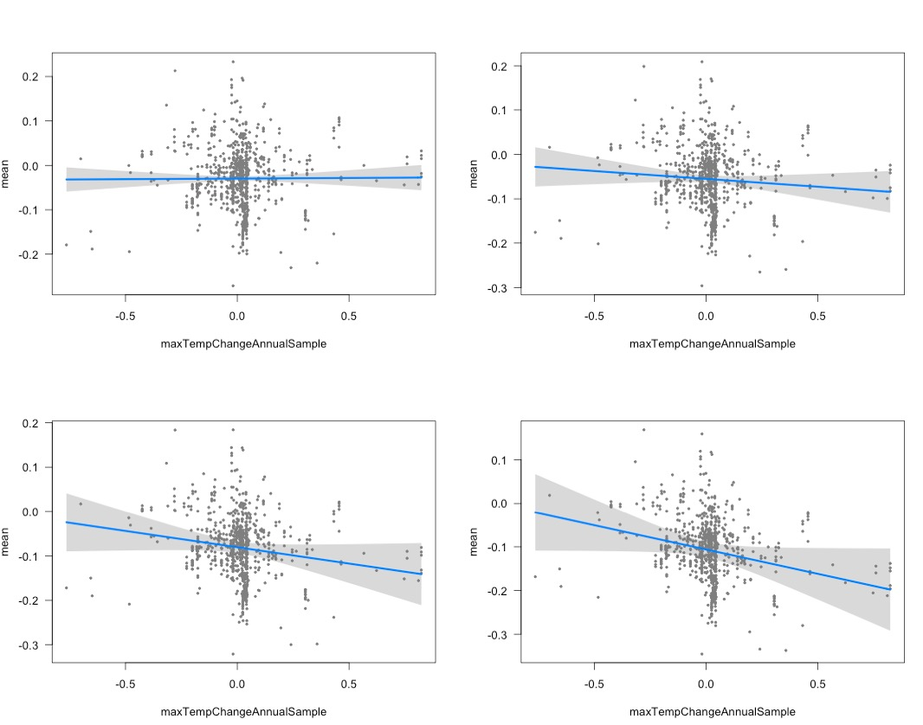

Slide 12
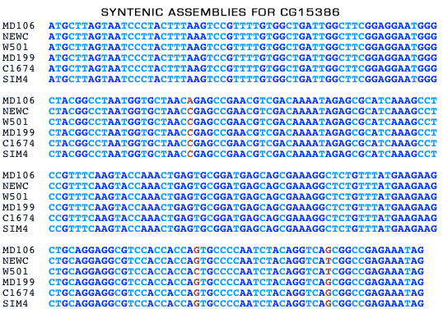

Slide 13
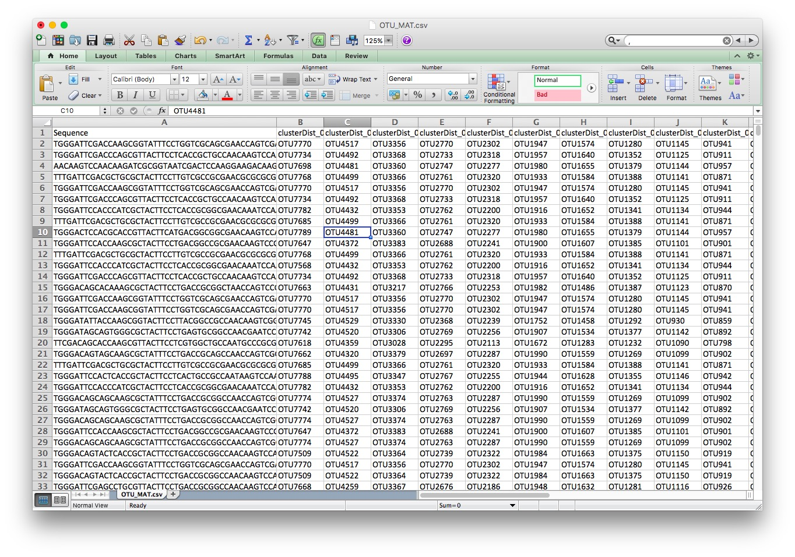

Slide 14
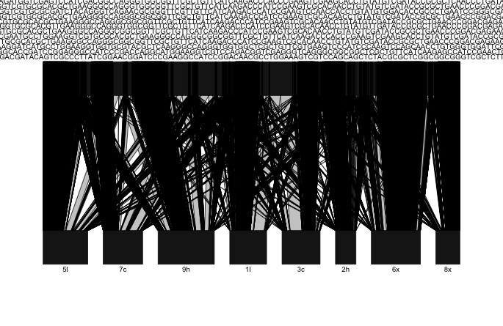

Slide 15
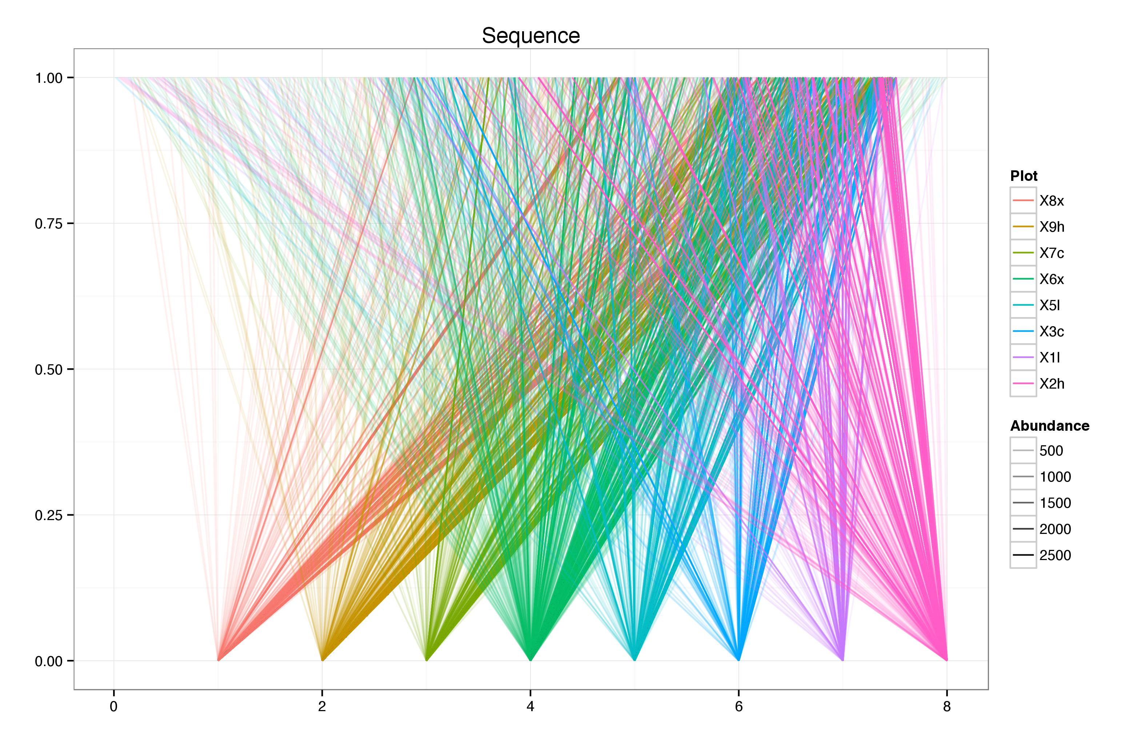

Slide 16
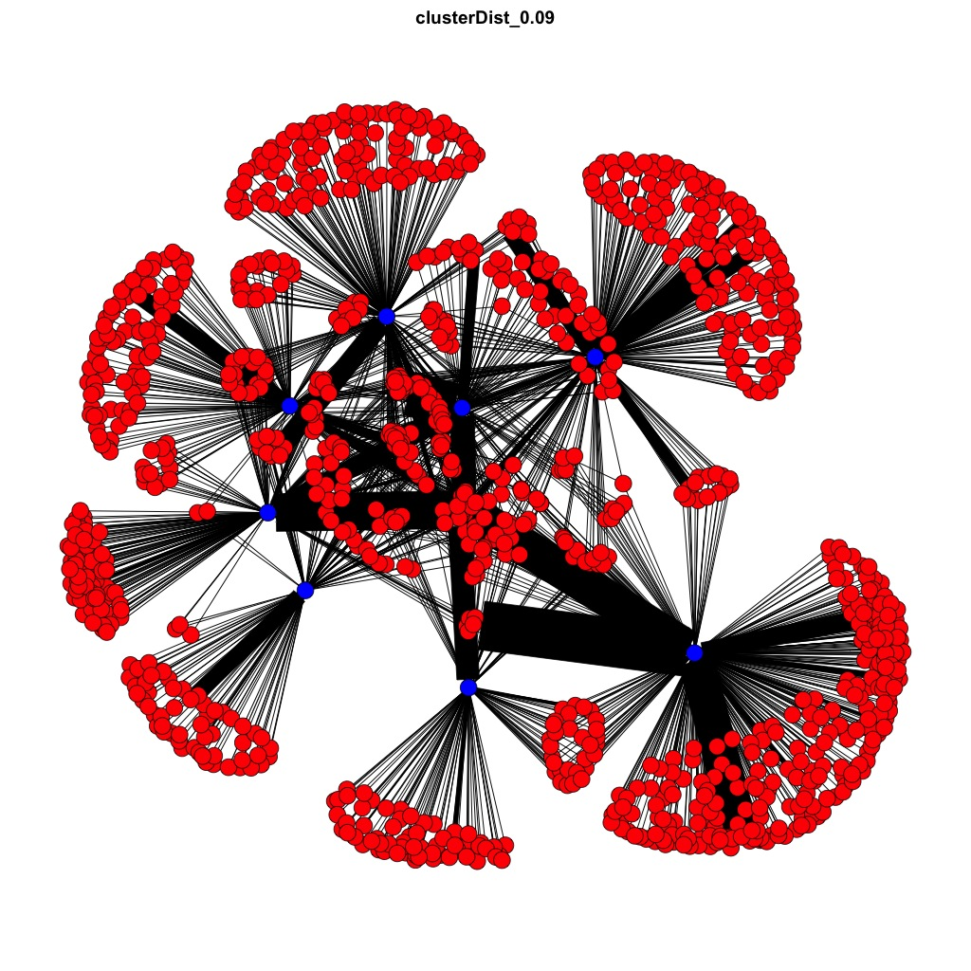

Slide 17
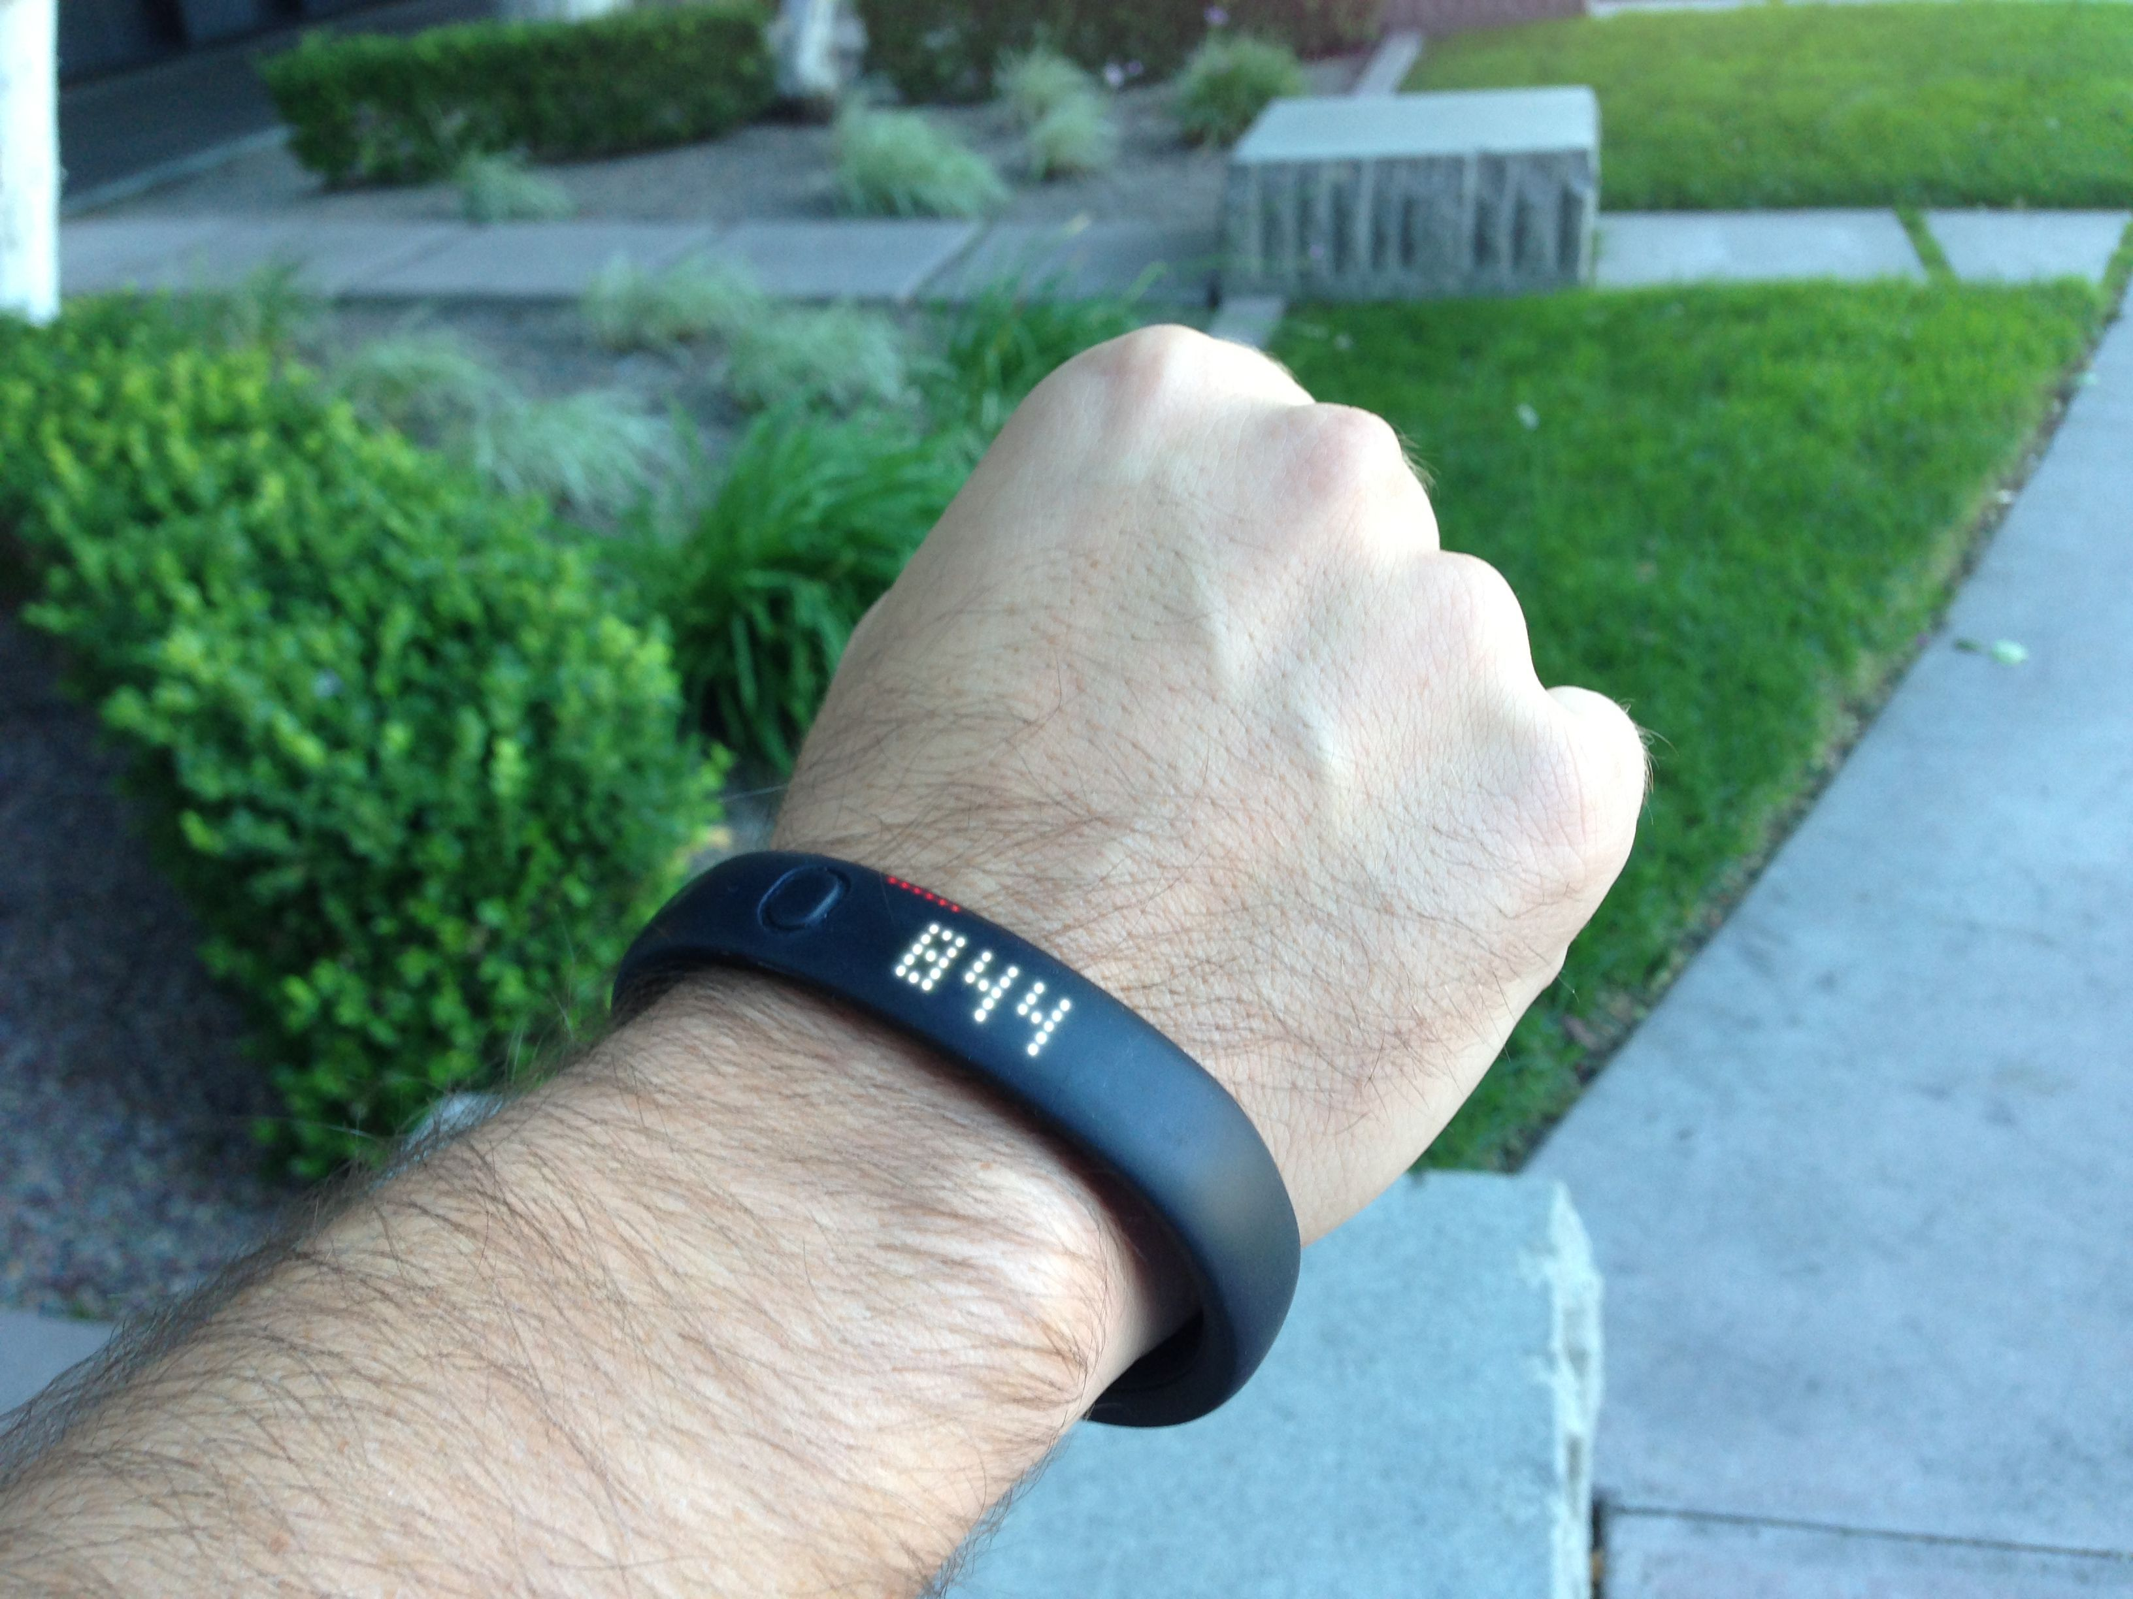

Slide 18
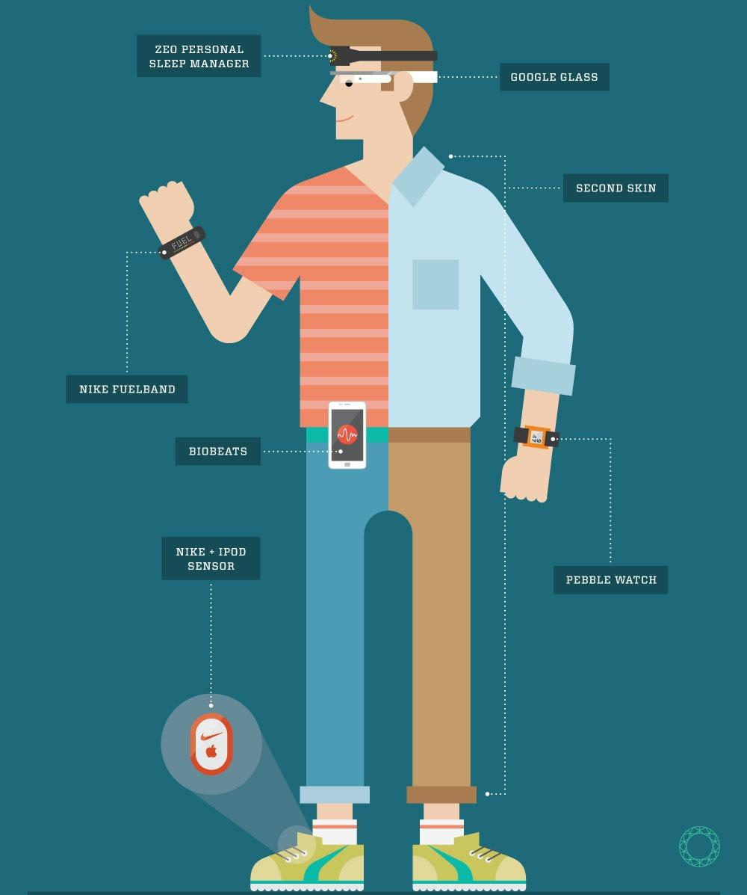

Slide 19


Slide 20
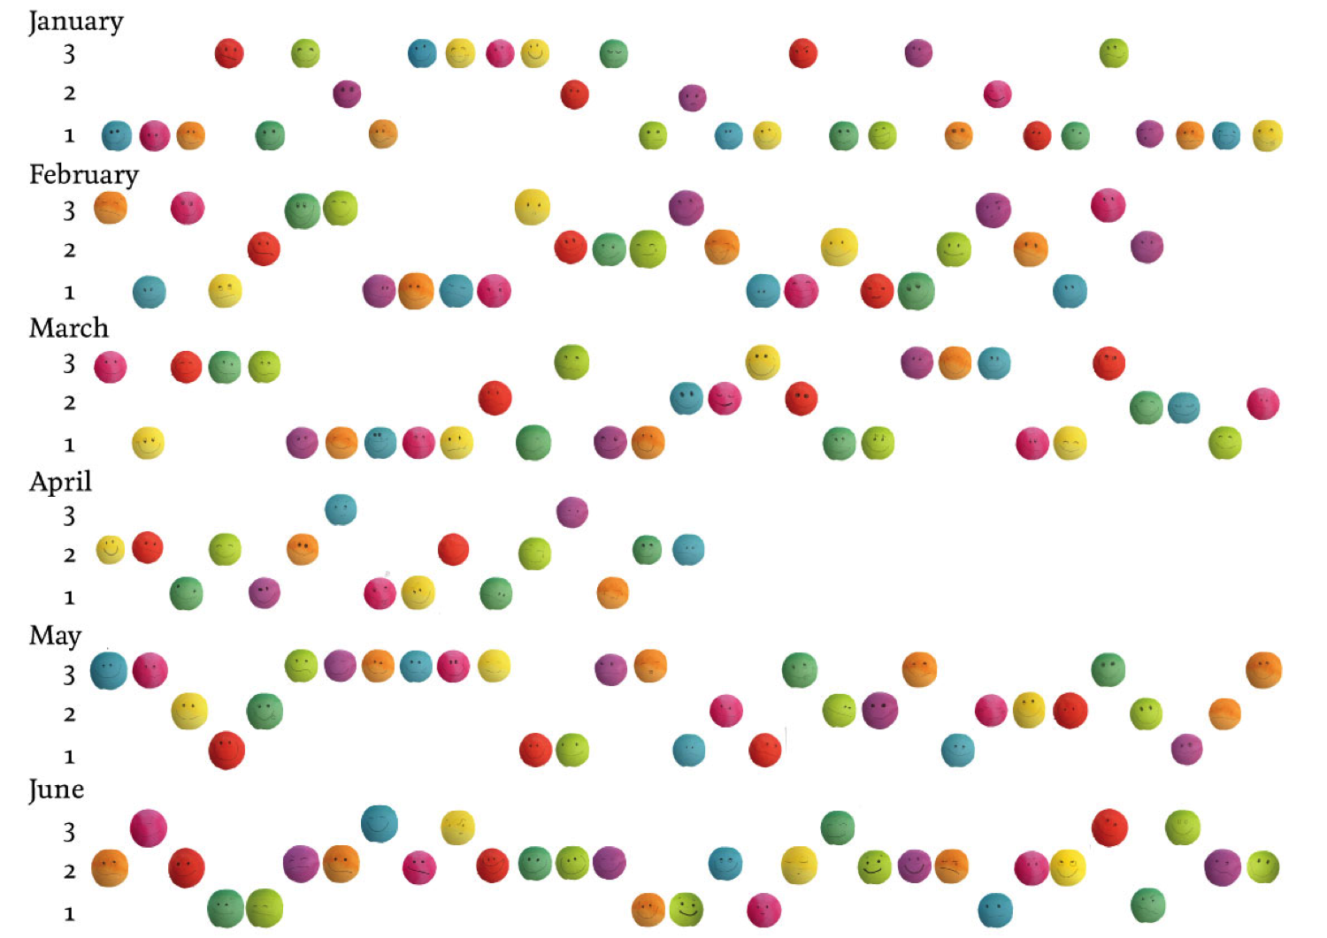

Slide 21
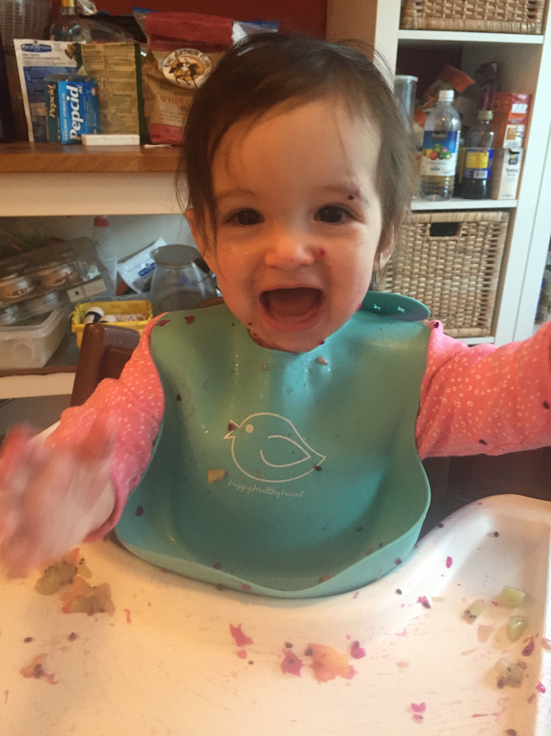

Slide 22
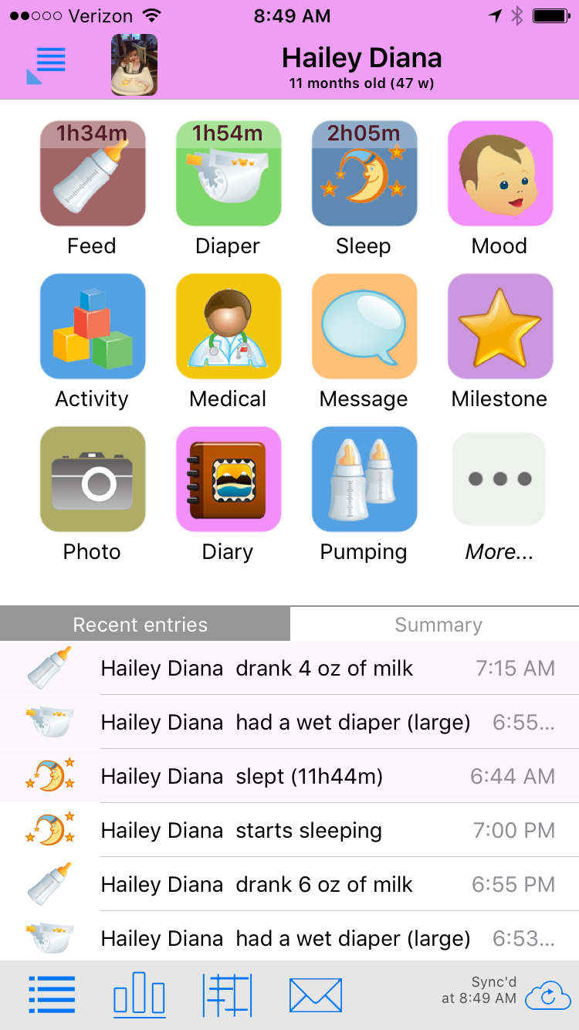

Slide 23
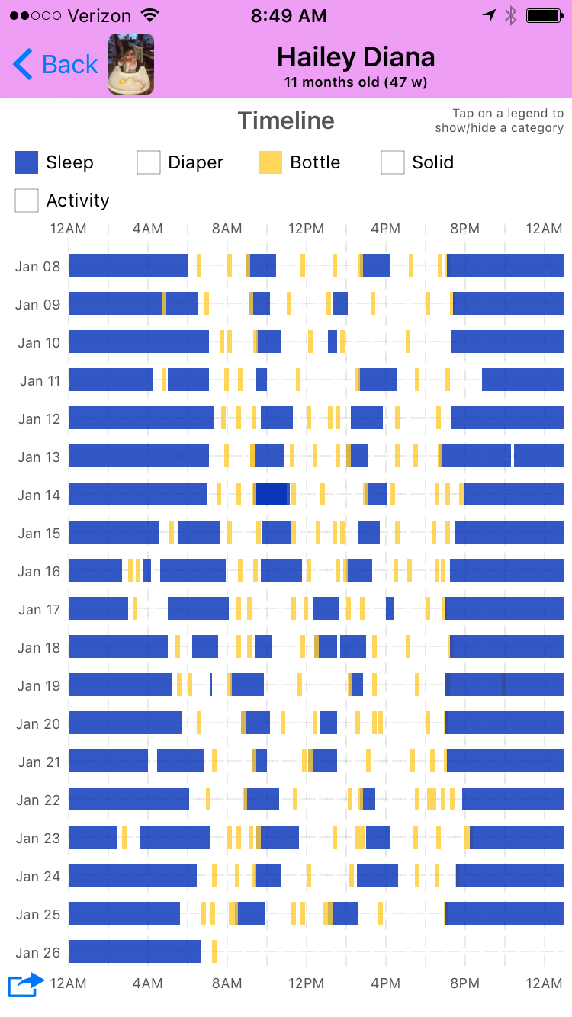

Slide 24
We Are Awash in Data

Slide 25
Data Takes Many Forms
Athletic performance
Timeseries of polls
Sequence Data
Measurements of physical properties
Maps (often with many layers) with information
Timings of events
Images
Network descriptions
Plain text

Slide 26
Data is at the Center of Biology

Slide 27
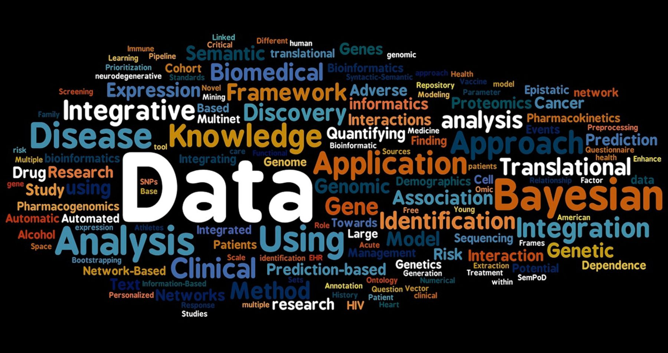

Slide 28
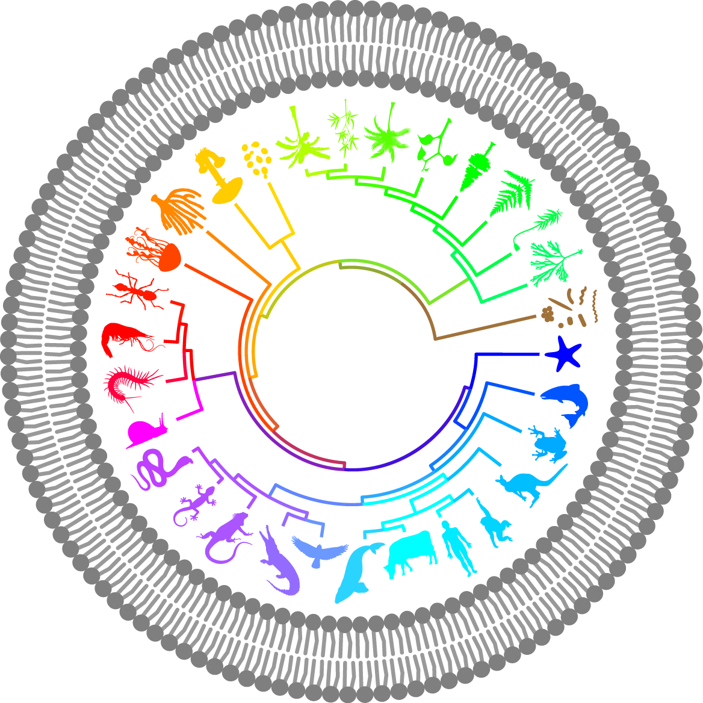

Slide 29
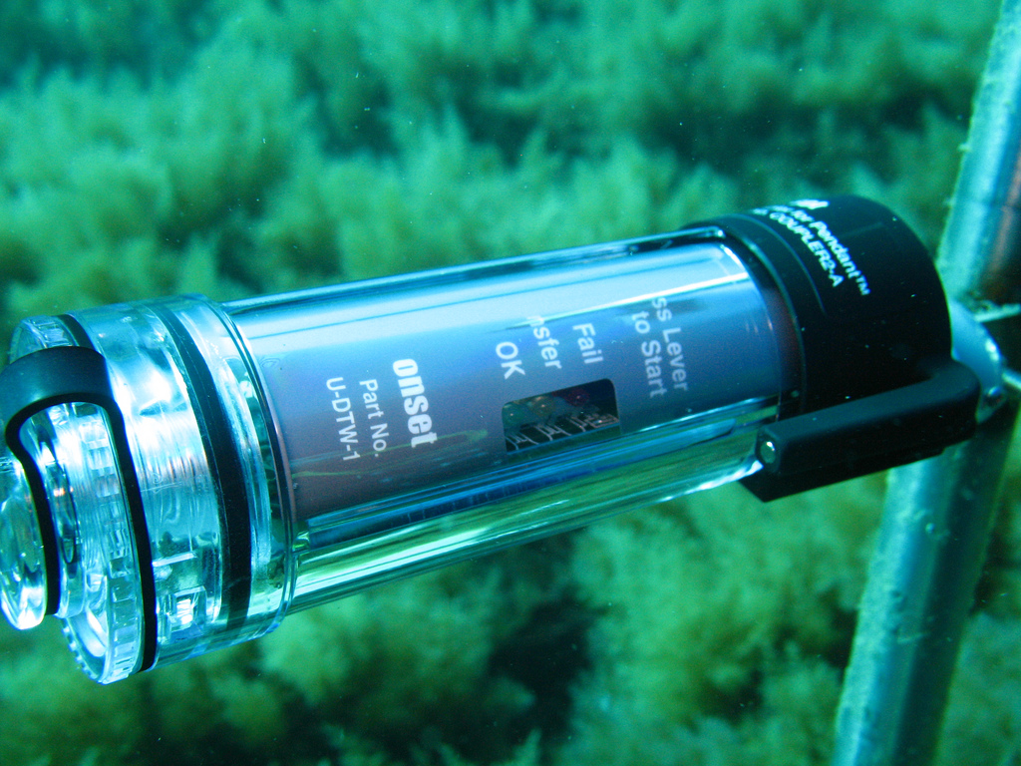

Slide 30
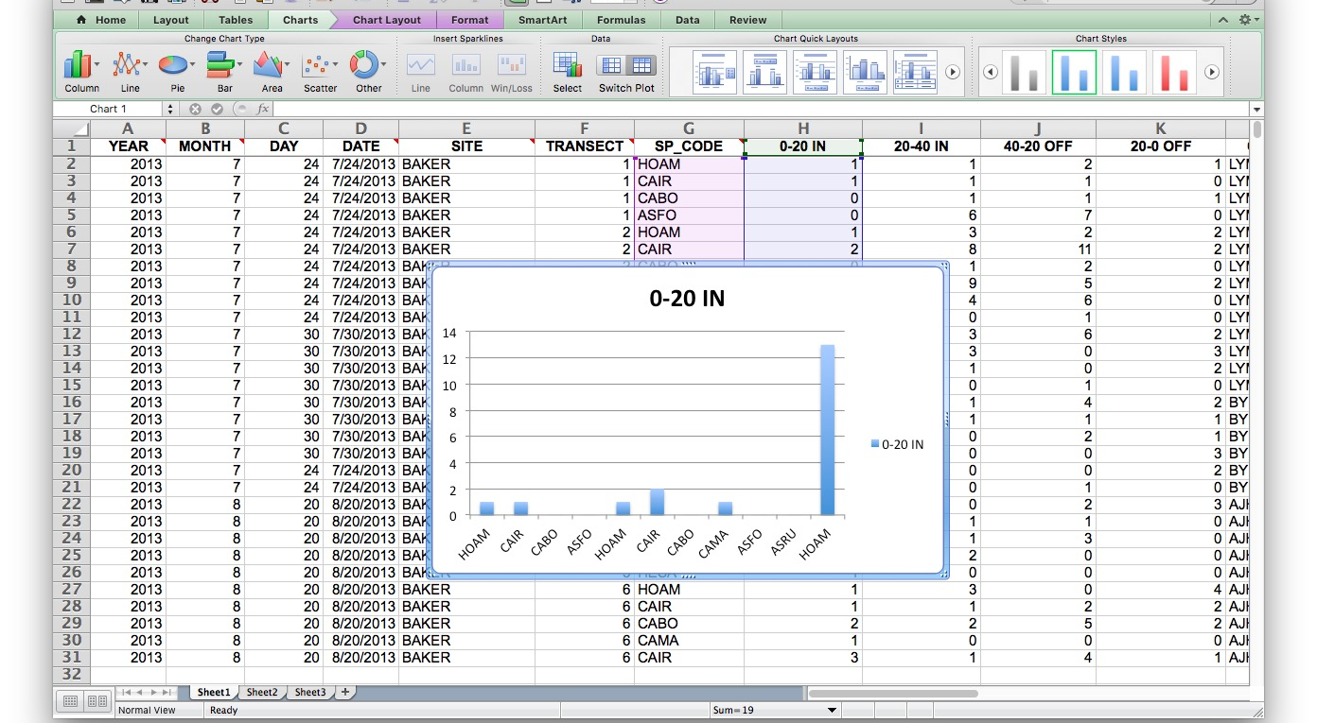
Classical Tools Not Up to the Task

Slide 31
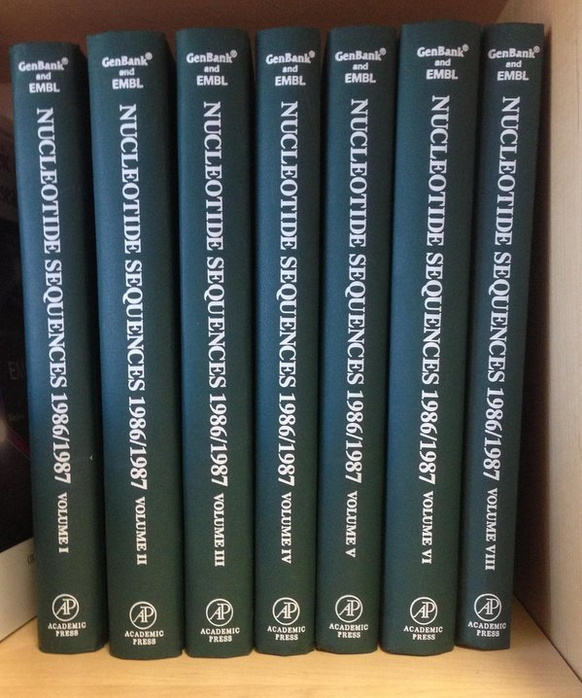
Classical Tools Not Up to the Task

Slide 32
Introduction to Data Science for Biology

Slide 33
Who Are You?

Slide 34
Our Semester

Slide 35
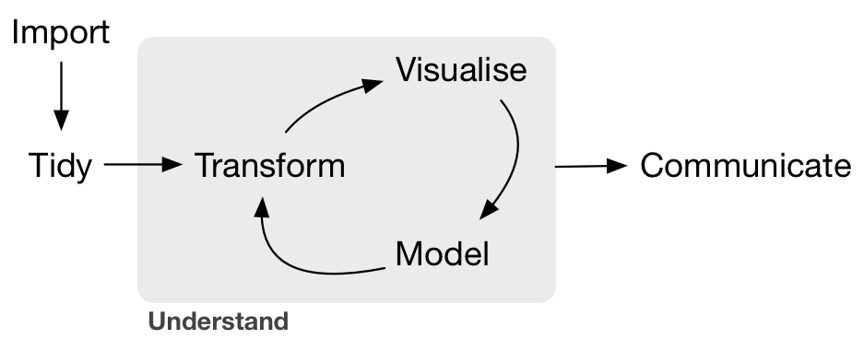

Slide 36
Learn how to create efficient understandable datasets for biological research
YEAR | MONTH | DAY | DATE | SITE | TRANSECT | SP_CODE | 0-20 IN | 20-40 IN | 40-20 OFF | 20-0 OFF | OBSERVER
2013 | 7 | 24 | 7/24/2013 | BAKER | 1 | HOAM | 1 | 1 | 2 | 1 | LYMAN
2013 | 7 | 24 | 7/24/2013 | BAKER | 1 | CAIR | 1 | 1 | 1 | 0 | LYMAN
2013 | 7 | 24 | 7/24/2013 | BAKER | 1 | CABO | 0 | 1 | 1 | 1 | LYMAN
2013 | 7 | 24 | 7/24/2013 | BAKER | 1 | ASFO | 0 | 6 | 7 | 0 | LYMAN
2013 | 7 | 24 | 7/24/2013 | BAKER | 2 | HOAM | 1 | 3 | 2 | 2 | LYMAN
2013 | 7 | 24 | 7/24/2013 | BAKER | 2 | CAIR | 2 | 8 | 11 | 2 | LYMAN
2013 | 7 | 24 | 7/24/2013 | BAKER | 2 | CABO | 0 | 1 | 2 | 0 | LYMAN
2013 | 7 | 24 | 7/24/2013 | BAKER | 2 | CAMA | 1 | 9 | 5 | 2 | LYMAN
2013 | 7 | 24 | 7/24/2013 | BAKER | 2 | ASFO | 0 | 4 | 6 | 0 | LYMAN
2013 | 7 | 24 | 7/24/2013 | BAKER | 2 | ASRU | 0 | 0 | 1 | 0 | LYMAN

Slide 37

Learn common programming language(s) associated with data science

Slide 38


Slide 39


Slide 40
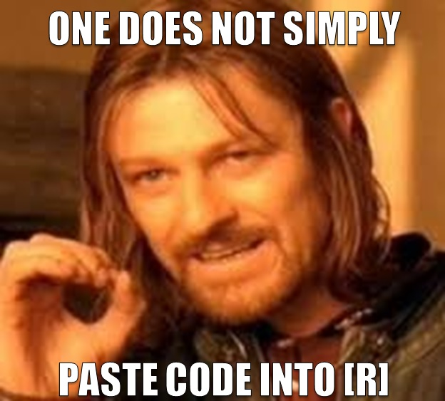

Slide 41
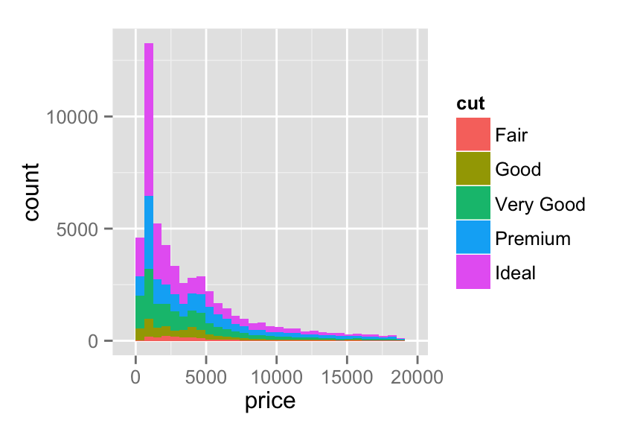
Build a vocabulary of visualization tools that enable students to see what their data means

Slide 42
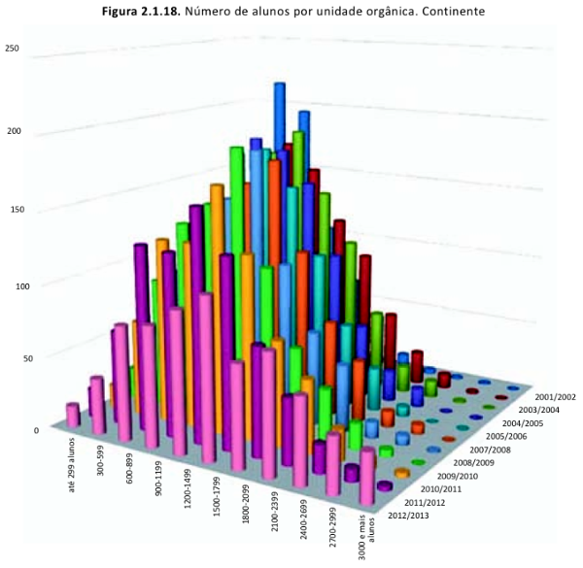
This is How I Know I Failed You

Slide 43
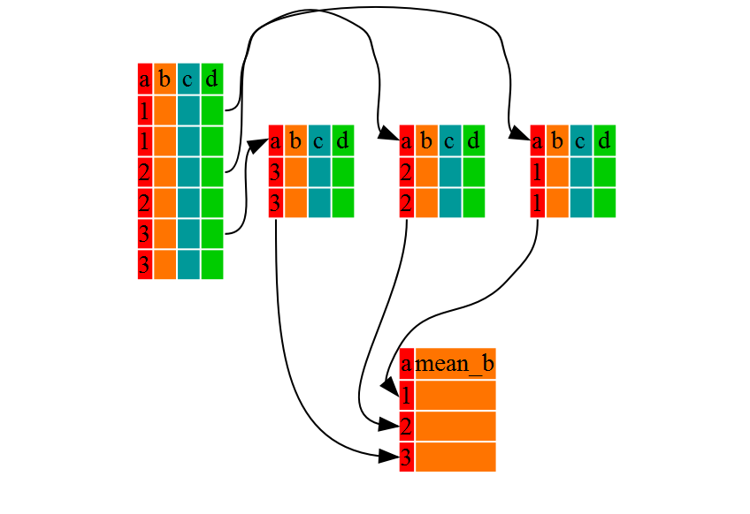
Develop an understanding of how to manipulate data for the purposes of seeing useful patterns
http://swcarpentry.github.io/r-novice-gapminder/

Slide 44
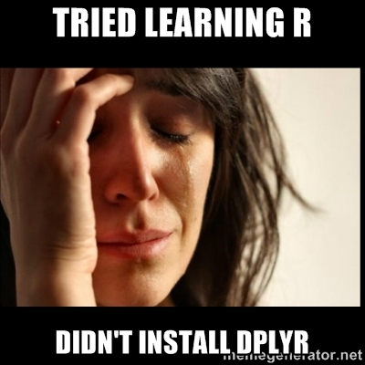

Slide 45
Understand how to unify data from disparate sources to build a larger picture of biological phenomena

Slide 46
Understand how to unify data from disparate sources to build a larger picture of biological phenomena

Slide 47

Learn basic analytical tools for deriving statistical inference from data

Slide 48
This Class

Slide 49
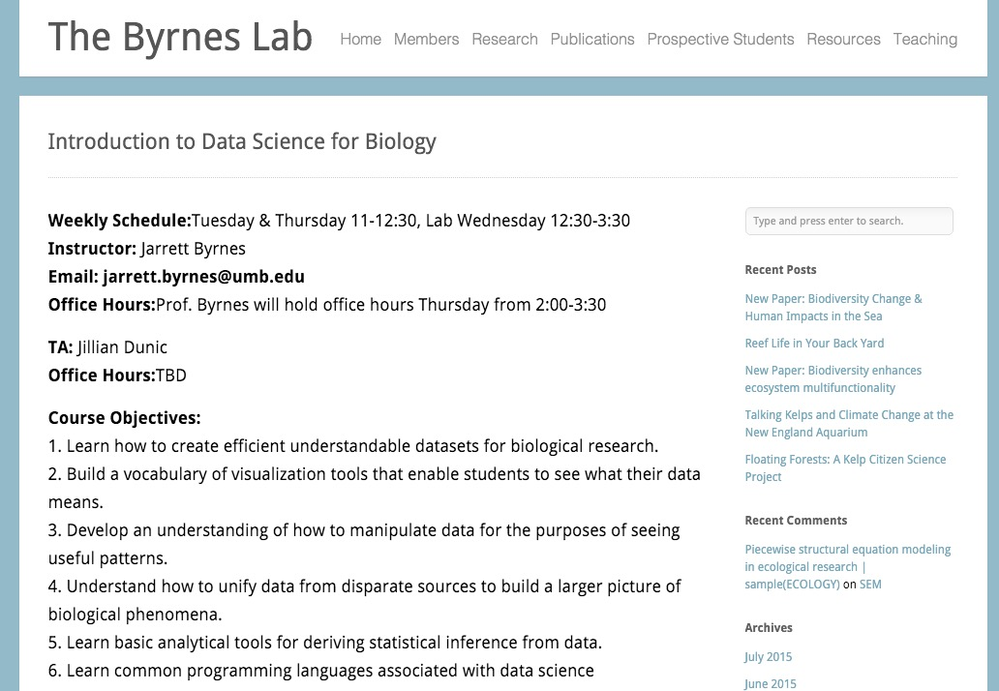
Course Web Page
http://byrneslab.net/teaching/data_science/

Slide 50
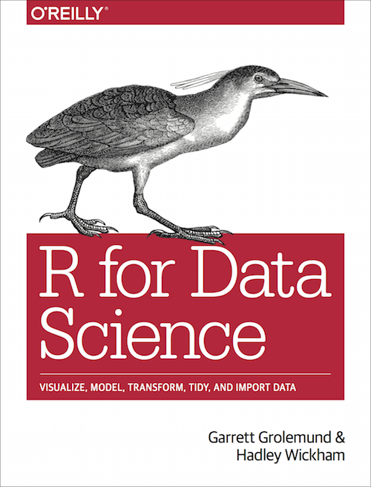
“Text”book & Weekly Readings
http://r4ds.had.co.nz/

Slide 51
Lab
Coding!
TA: Jillian Dunic
Guided examples and then challenge problems

Slide 52
Assignments
Weekly problem sets
Variable in scope!
May involve elements of your final project
Can be started in lab
Will highlight concepts from that week

Slide 53
Final Project
Analysis of a data set of your choosing
From your own work
Found data
Data mashups encouraged!
Bring together multiple public sources of data
Proposals due in two weeks
What data will you be using?
What question do you want to answer?

Slide 54
Next Time: Data Collection, Entry, and How to Make Your Data Usable (and have future you avoid wanting to kill now you)
(And listed to the Not So Standard Deviations Podcast)

